Slide 1
Bush v. Gore
Delaney Hillman

Slide 2
Dates & Case background
Dec. 8th 2000 – Dec. 12th 2000
Following the U.S. Supreme Court's decision in Bush v. Palm Beach County Canvassing Board, and concurrent with Vice President Al Gore's contest of the certification of Florida presidential election results, on December 8, 2000 the Florida Supreme Court ordered that the Circuit Court in Leon County tabulate by hand 9000 contested ballots from Miami-Dade County. It also ordered that every county in Florida must immediately begin manually recounting all "under-votes" (ballots which did not indicate a vote for president) because there were enough contested ballots to place the outcome of the election in doubt. Governor George Bush and his running mate, Richard Cheney, filed a request for review in the U.S. Supreme Court and sought an emergency petition for a stay of the Florida Supreme Court's decision. The U.S. Supreme Court granted review and issued the stay on December 9.

Slide 3
Case facts
December 8th 2000 Florida issued a manual recount of over 10,000 ballots
There was a problem with the electric voting machine punching ballots wrong
The supreme court found that the recount violated the 19th amendment
The recounting procedure violated the Equal protection law
December 11th 2000 was brought to the supreme court Bush v Gore

Slide 4
Verdict
With the termination of the recount process, Florida’s 25 electoral votes were awarded to Bush. Gore officially conceded on December 13 and stated in a televised address, “While I strongly disagree with the Court’s decision, I accept it.”

Slide 5
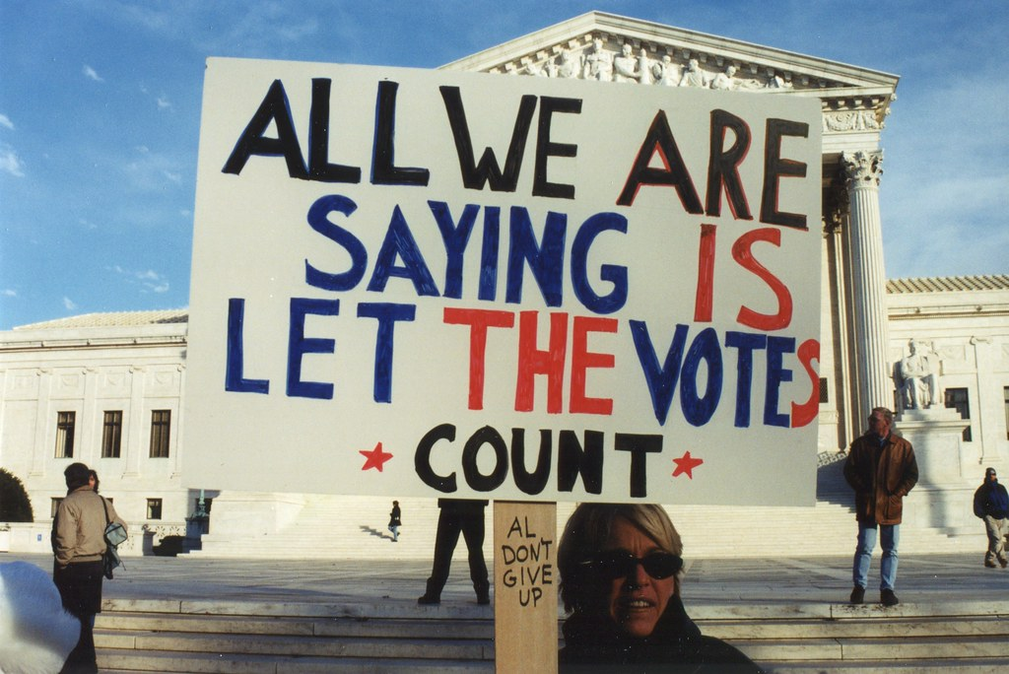
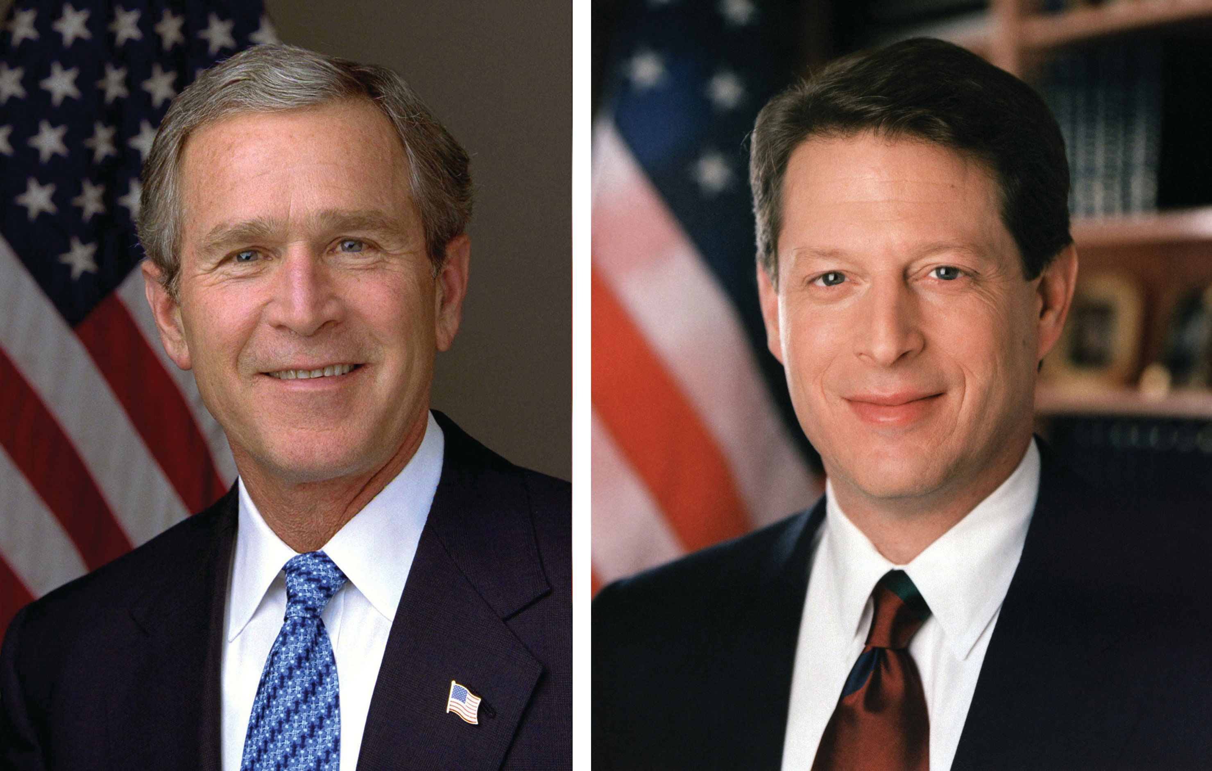
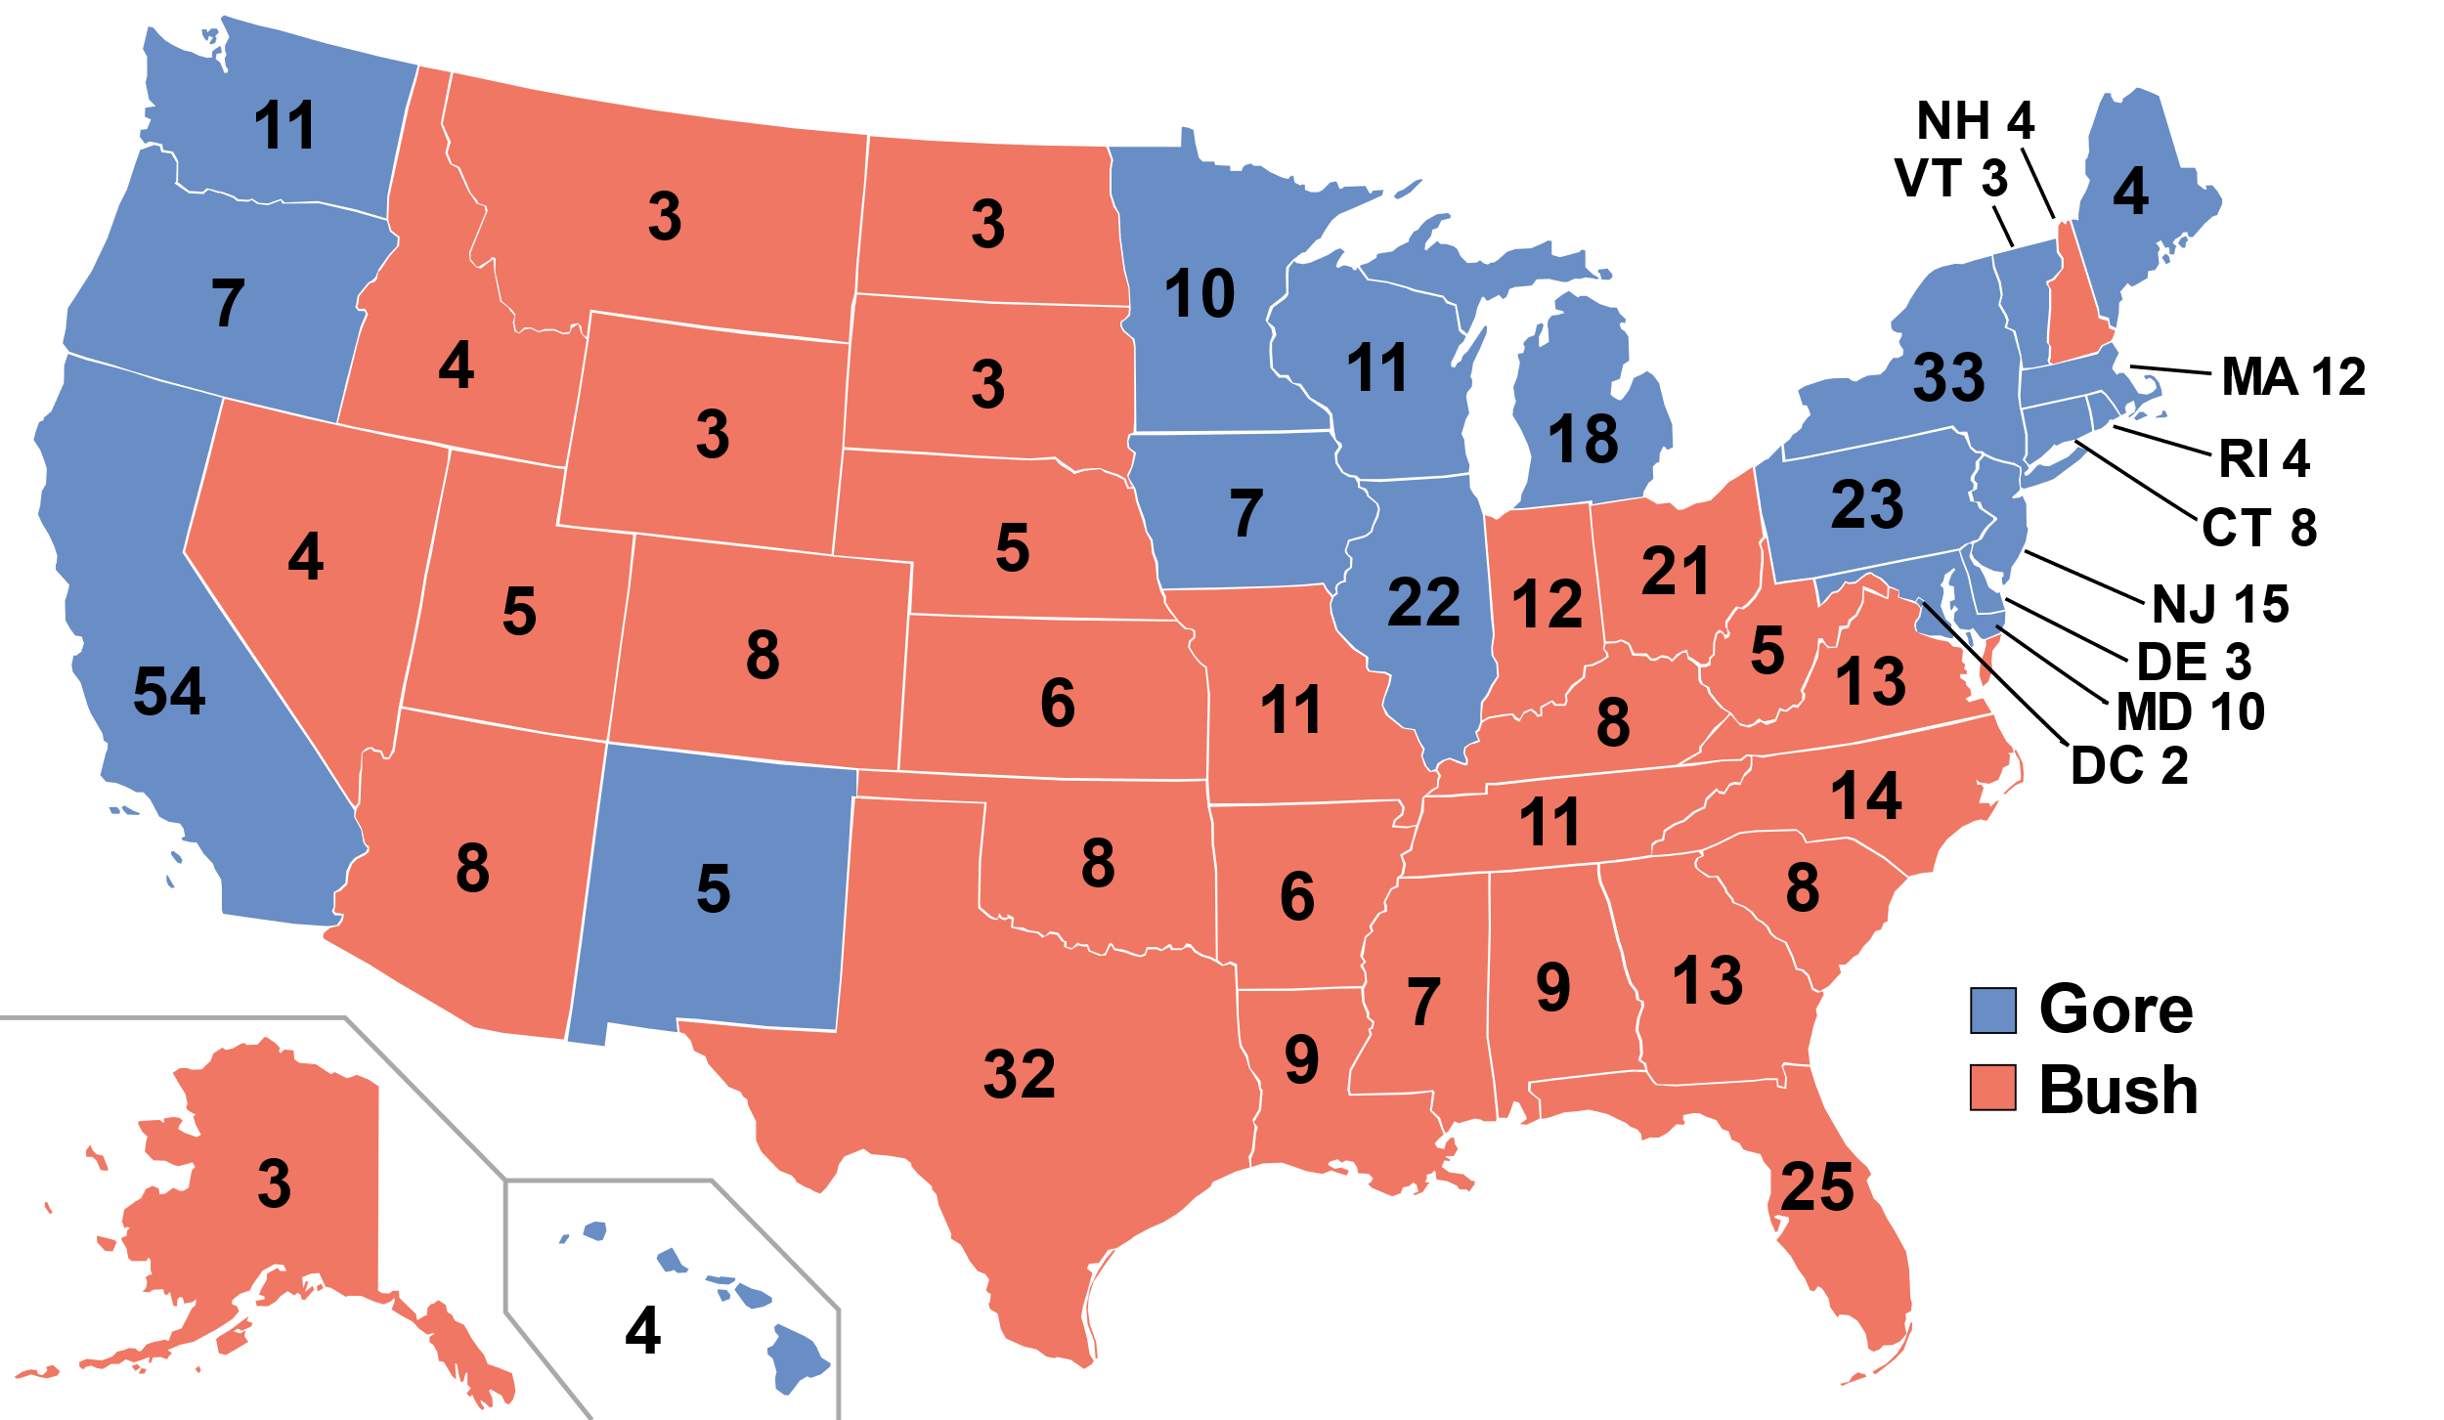

Slide 6
Sources
Britannica
Haikudeck
oyez

